Slide 1
Permutation and combination
Shreyas M
B.Tech in ECE PES University Bangalore

Slide 2
Chapter Map
Section | Topic
1 | Introduction
2 | Factorial notation
3 | Fundamental Principle of Counting (FPC)
4 | Linear Permutation without repetition
5 | Linear Permutation assuming repetition
6 | Circular permutation
7 | Combination

Slide 3
1 Introduction
The concept of permutations and combinations is used all over the world in most ways humans could think off.
Lets say you lock yourself out of your bag with a combination lock. Cracking the code, is not a tedious job if you know the concept of Permutations.
Apart from being used in such common day-to-day situations, these concepts are widely used in industry of communication system design as well such as calculating the Probability of Error in data received, or even predicting the possible data “TO-BE” received .

Slide 4


2 Factorial Notation
An important pre-requisite to understand this unit is the concept of factorial notation.
Factorial is defined as the product of first N natural numbers
⚠️Despite not being considered in factorial 0! Is considered to be 1.
In general, N factorial is denoted as
N!=N.(N-1)!=N.(N-1).(N-2)! = … = N.(N-1).(N-2). … .3.2.1
$\frac{N!}{\left(N−1\right)!}=N$
$A!+B!≠\left(A+B\right)!$
$A!× B!≠\left(AB\right)!$
An important result :
Let P be prime number. The highest power of P in N! is APPROXIMATELY given by
$\boxed{\text{K}\text{=}\left(\sum{\frac{n}{p^{i}}}\right)−1 }$ If You want to find the highest of a non-prime, factorize the given number and calculate the highest power of each. The smallest is the one.

Slide 5
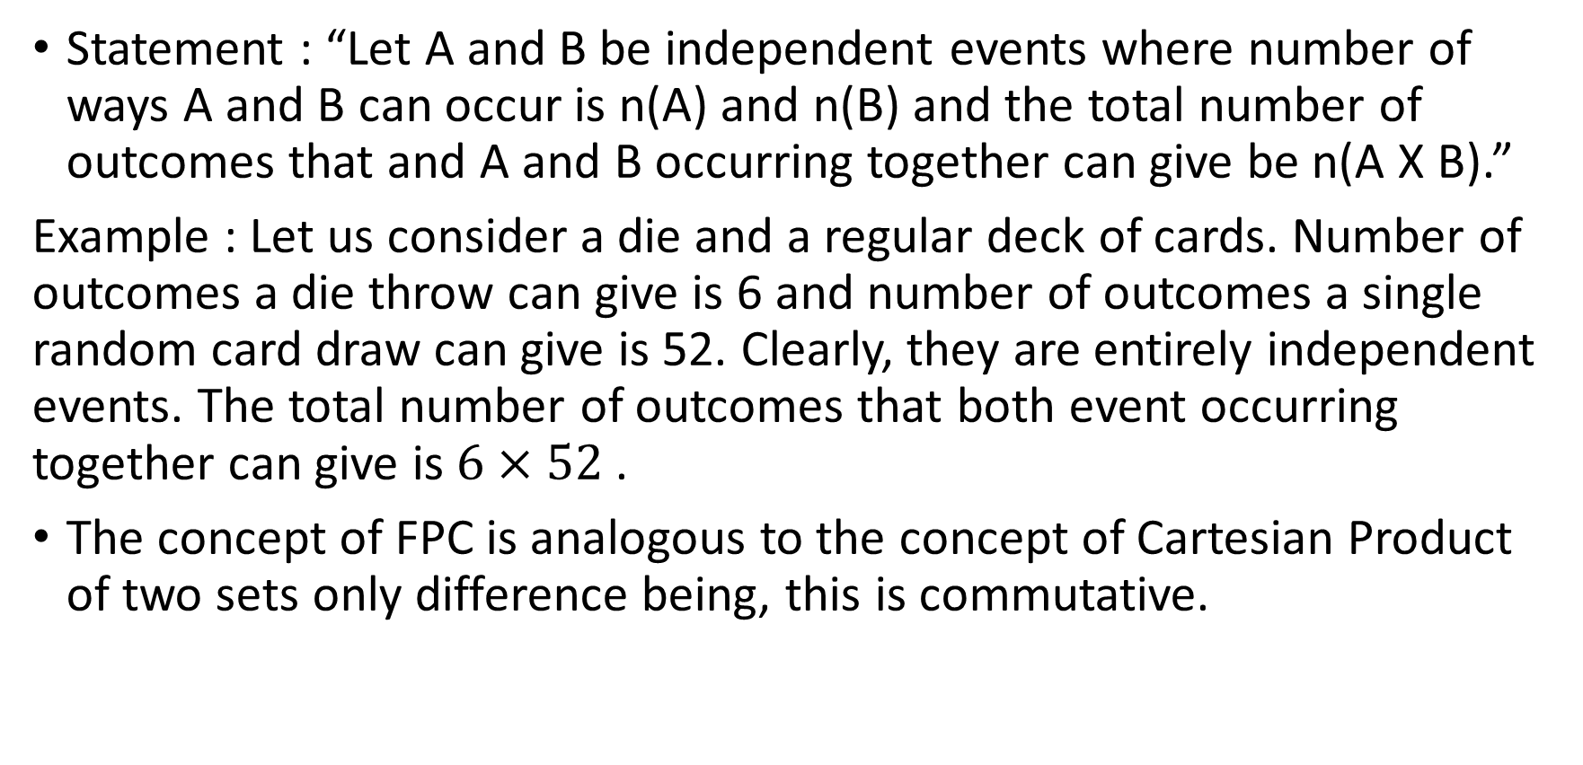
3 Fundamental Principle of Counting (FPC)
Statement : “Let A and B be independent events where number of ways A and B can occur is n(A) and n(B) and the total number of outcomes that and A and B occurring together can give be n(A X B).”
Example : Let us consider a die and a regular deck of cards. Number of outcomes a die throw can give is 6 and number of outcomes a single random card draw can give is 52. Clearly, they are entirely independent events. The total number of outcomes that both event occurring together can give is $6×52$ .
The concept of FPC is analogous to the concept of Cartesian Product of two sets only difference being, this is commutative.

Slide 6
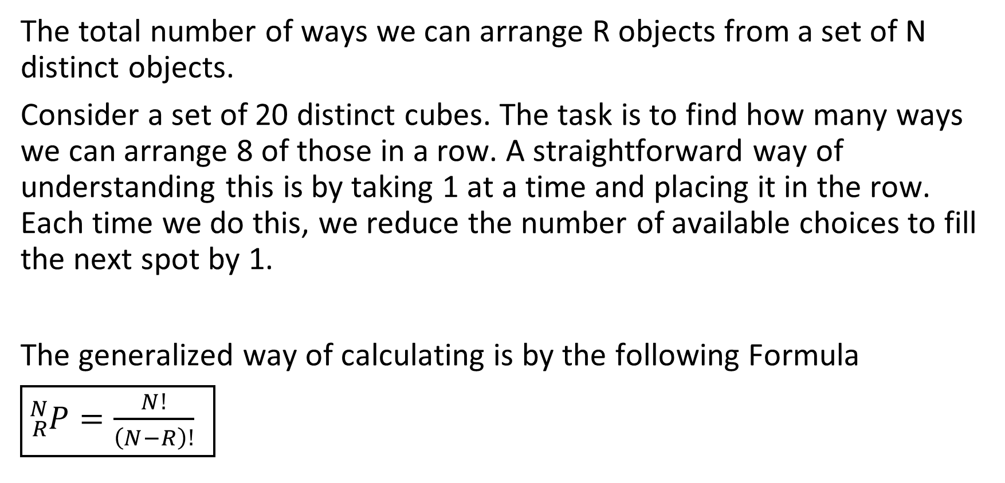
4 Linear Permutation without repetition
The total number of ways we can arrange R objects from a set of N distinct objects.
Consider a set of 20 distinct cubes. The task is to find how many ways we can arrange 8 of those in a row. A straightforward way of understanding this is by taking 1 at a time and placing it in the row. Each time we do this, we reduce the number of available choices to fill the next spot by 1.
The generalized way of calculating is by the following Formula
$\boxed{{}_{R}^{N}P=\frac{N!}{\left(N−R\right)!} }$
20 | 19 | 18 | 17 | 16 | 15 | 14 | 13

Slide 7
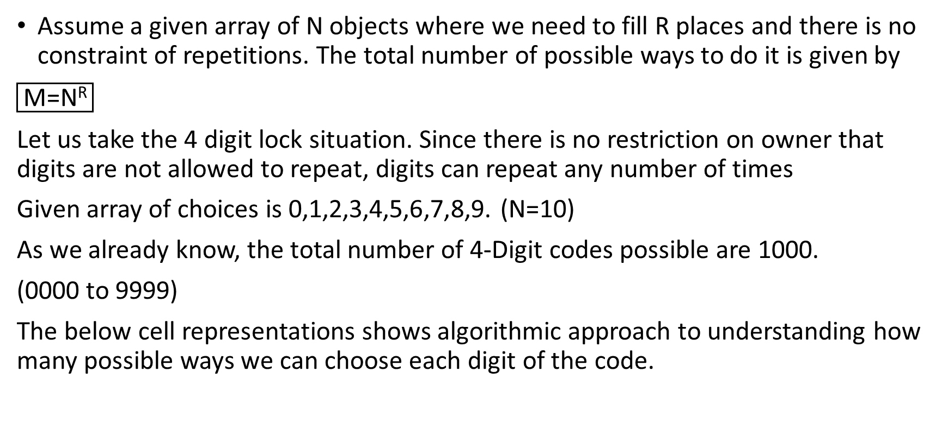
5 Linear permutation with repetition
Assume a given array of N objects where we need to fill R places and there is no constraint of repetitions. The total number of possible ways to do it is given by
$\boxed{\text{M}\text{=}\text{NR}}$
Let us take the 4 digit lock situation. Since there is no restriction on owner that digits are not allowed to repeat, digits can repeat any number of times
Given array of choices is 0,1,2,3,4,5,6,7,8,9. (N=10)
As we already know, the total number of 4-Digit codes possible are 1000.
(0000 to 9999)
The below cell representations shows algorithmic approach to understanding how many possible ways we can choose each digit of the code.
10 | 10 | 10 | 10

Slide 8
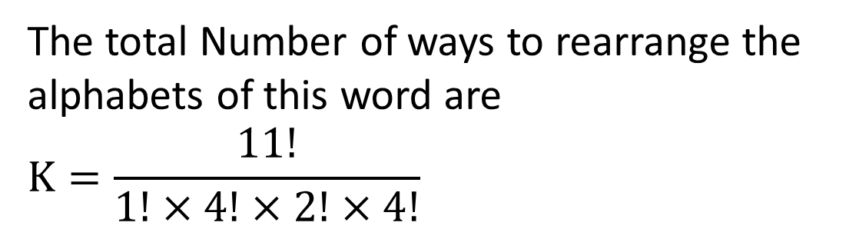
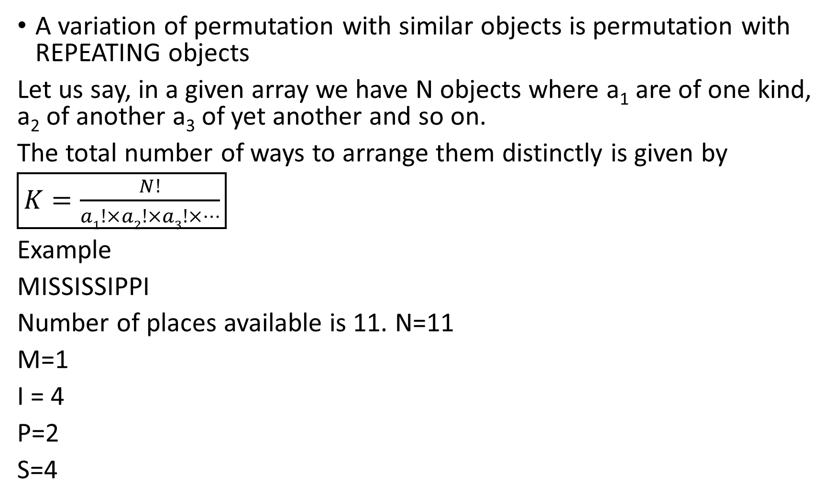
A variation of permutation with similar objects is permutation with REPEATING objects
Let us say, in a given array we have N objects where a₁ are of one kind, a₂ of another a₃ of yet another and so on.
The total number of ways to arrange them distinctly is given by
$\boxed{K=\frac{N!}{a1!×a2!×a3!×…}}$
Example
MISSISSIPPI
Number of places available is 11. N=11
M=1
I = 4
P=2
S=4
The total Number of ways to rearrange the alphabets of this word are
$$K=\frac{11!}{1!×4!×2!×4!}$$

Slide 9
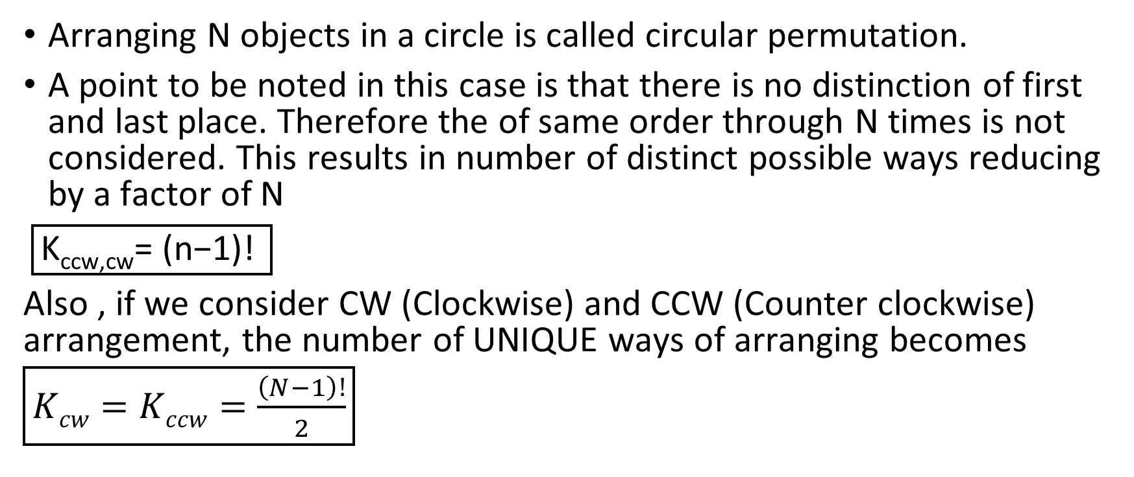
6 Circular permutation
Arranging N objects in a circle is called circular permutation.
A point to be noted in this case is that there is no distinction of first and last place. Therefore the of same order through N times is not considered. This results in number of distinct possible ways reducing by a factor of N
$\boxed{\text{K}\text{ccw}\text{,}\text{cw}\text{= (}\text{n}\text{−}\text{1}\text{)! }}$
Also , if we consider CW (Clockwise) and CCW (Counter clockwise) arrangement, the number of UNIQUE ways of arranging becomes
$\boxed{Kcw=Kccw=\frac{\left(N−1\right)!}{2}}$

Slide 10
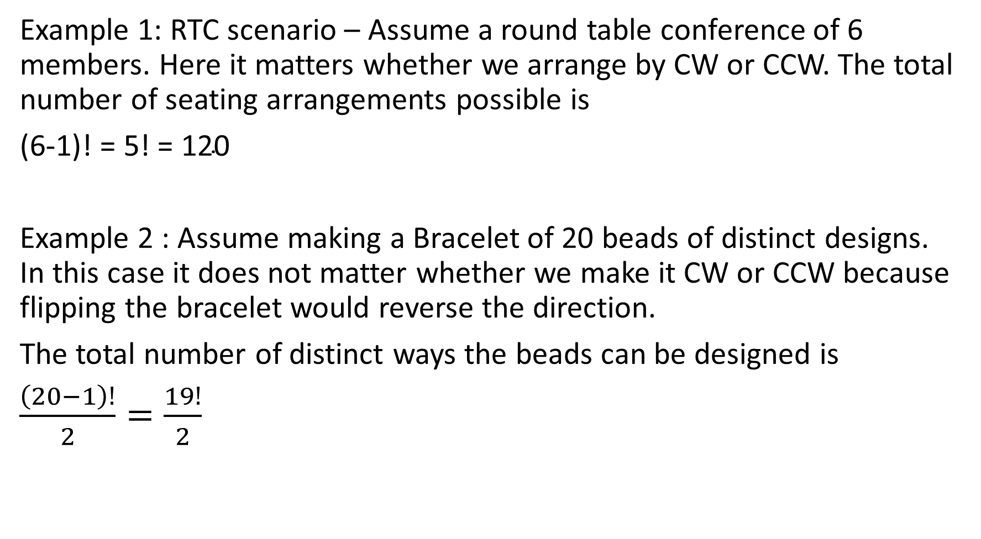
Example 1: RTC scenario – Assume a round table conference of 6 members. Here it matters whether we arrange by CW or CCW. The total number of seating arrangements possible is
$\text{(6−1)! = 5! = 120}$
Example 2 : Assume making a Bracelet of 20 beads of distinct designs. In this case it does not matter whether we make it CW or CCW because flipping the bracelet would reverse the direction.
The total number of distinct ways the beads can be designed is
$\frac{\left(20−1\right)!}{2}=\frac{19!}{2}$

Slide 11
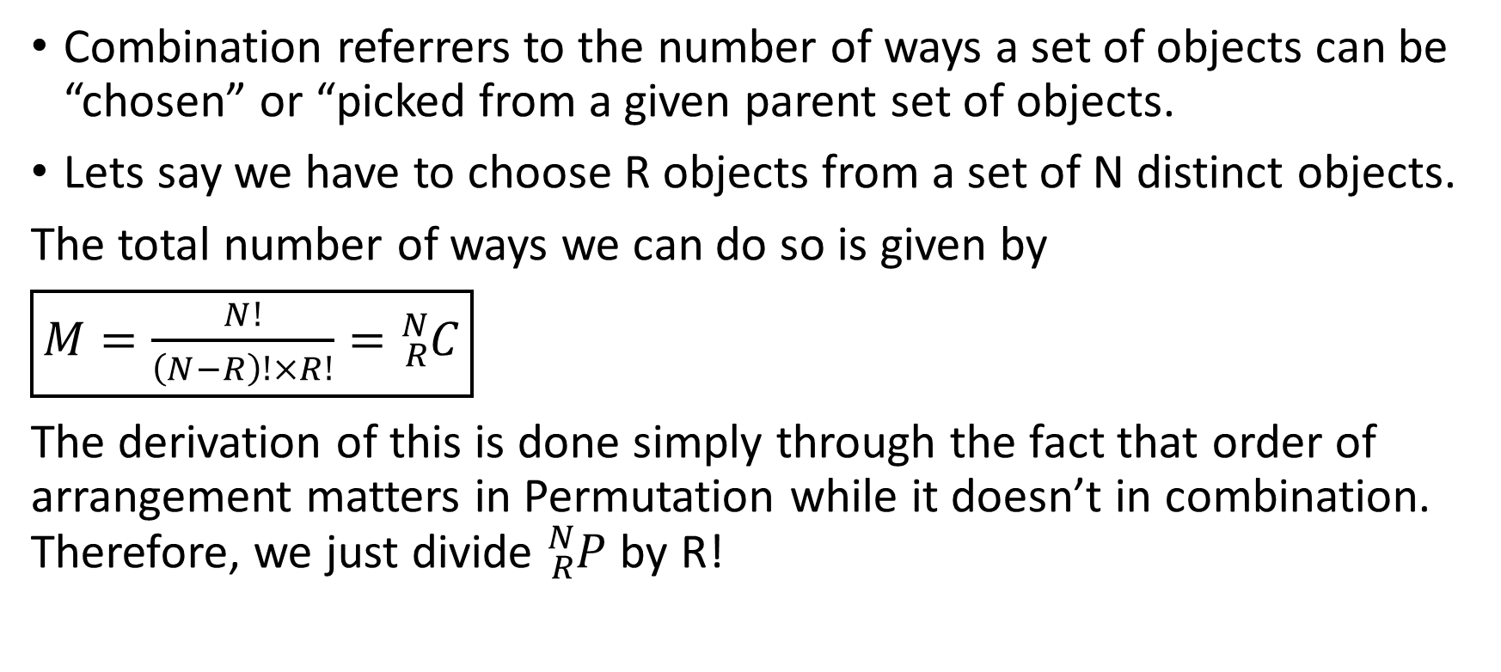
7 Combination
Combination referrers to the number of ways a set of objects can be “chosen” or “picked from a given parent set of objects.
Lets say we have to choose R objects from a set of N distinct objects.
The total number of ways we can do so is given by
$\boxed{M=\frac{N!}{\left(N−R\right)!×R!}={}_{R}^{N}C}$
The derivation of this is done simply through the fact that order of arrangement matters in Permutation while it doesn’t in combination. Therefore, we just divide ${}_{R}^{N}P$ by R!

Slide 12
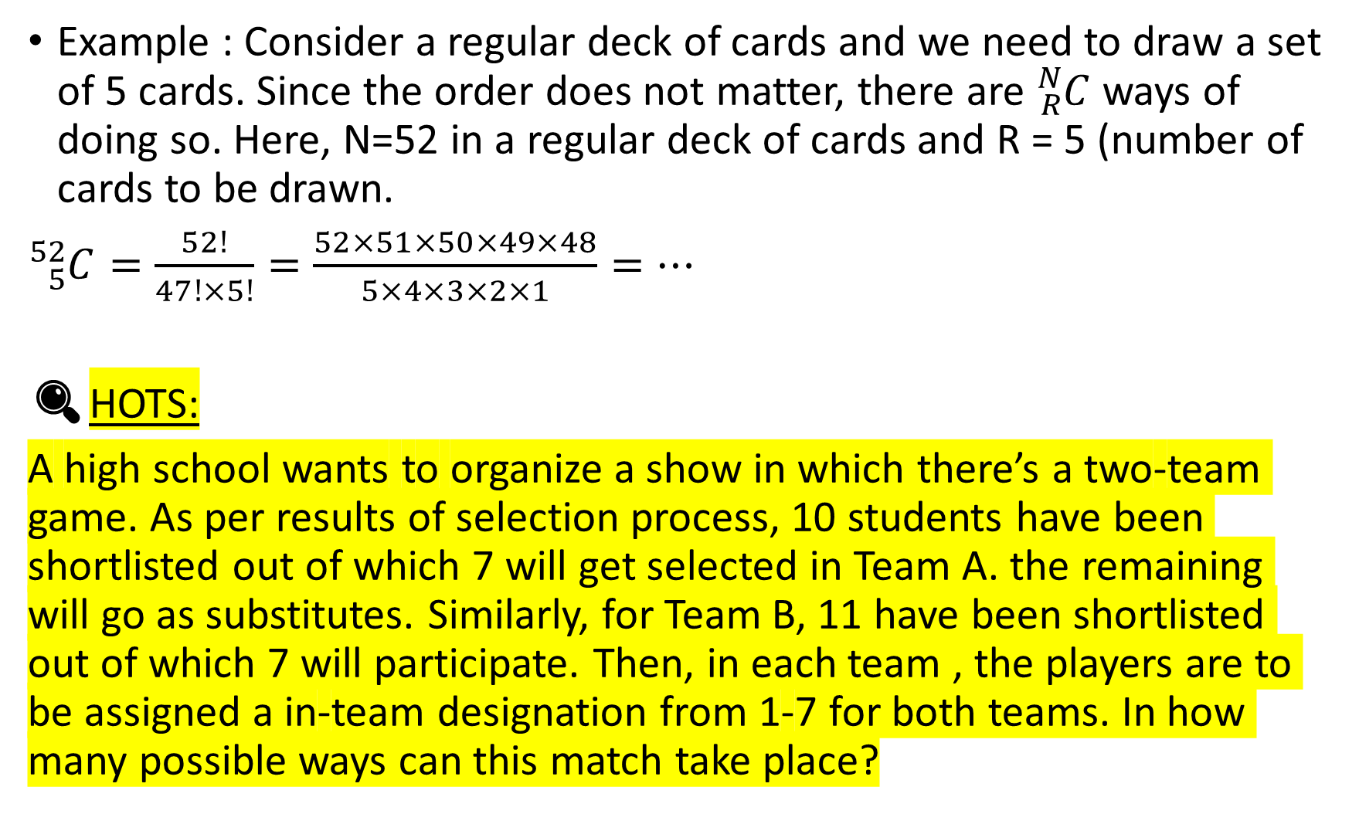
Example : Consider a regular deck of cards and we need to draw a set of 5 cards. Since the order does not matter, there are ${}_{R}^{N}C$ ways of doing so. Here, N=52 in a regular deck of cards and R = 5 (number of cards to be drawn.
${}_{5}^{52}C=\frac{52!}{47!×5!}=\frac{52×51×50×49×48}{5×4×3×2×1}=…$
🔍HOTS:
A high school wants to organize a show in which there’s a two-team game. As per results of selection process, 10 students have been shortlisted out of which 7 will get selected in Team A. the remaining will go as substitutes. Similarly, for Team B, 11 have been shortlisted out of which 7 will participate. Then, in each team , the players are to be assigned a in-team designation from 1-7 for both teams. In how many possible ways can this match take place?

Slide 13
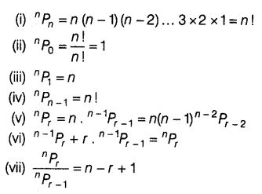
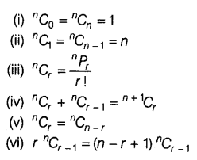
8 Some important PnC formulae

Slide 14
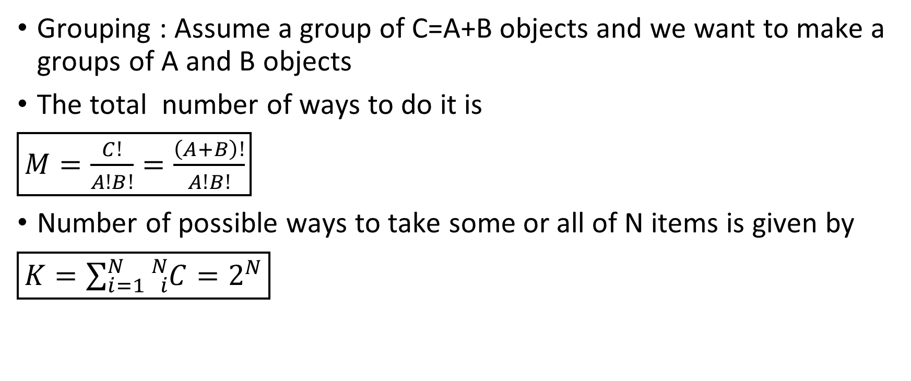
9 Grouping and taking
Grouping : Assume a group of C=A+B objects and we want to make a groups of A and B objects
The total number of ways to do it is
$\boxed{M=\frac{C!}{A!B!}=\frac{\left(A+B\right)!}{A!B!}}$
Number of possible ways to take some or all of N items is given by
$\boxed{K=\sum_{i=1}^{N}{{}_{i}^{N}C}=2^{N}}$

Slide 15
Thank you
Shreyas M
B.Tech in ECE PES University Bangalore

